Slide 1
ITT565 Chapter 3 Managing Files Services

Slide 2
Managing File Services
Notes on Windows installation
Managing the files services (Windows)

Slide 3
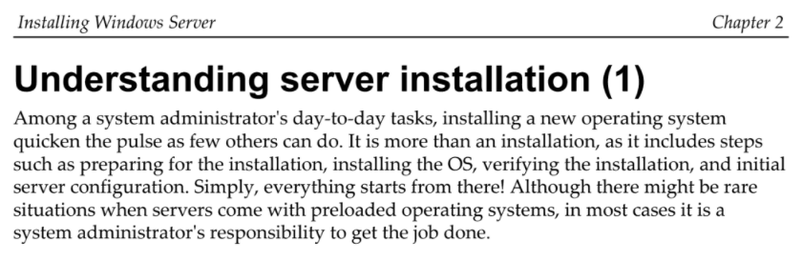
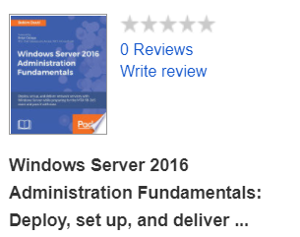
Notes on Windows installation
Ref.
Installation of new operating system
Verify the installation
Initial server configuration

Slide 4
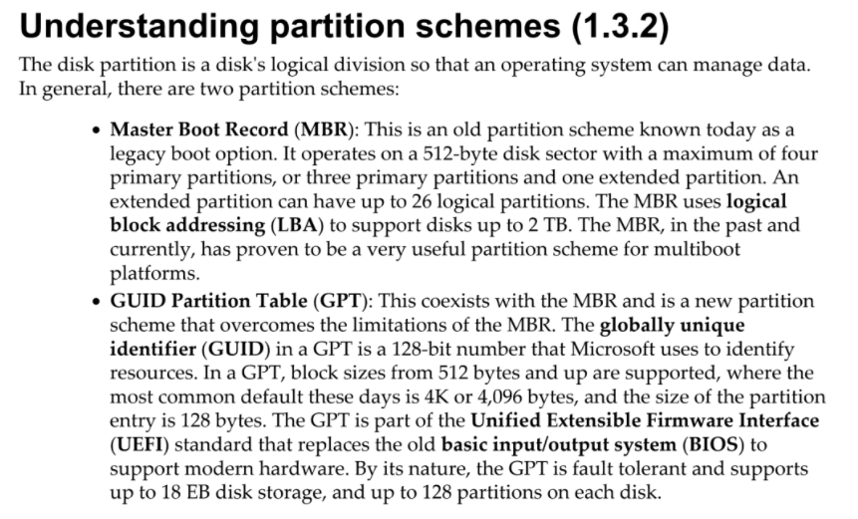
Ref.

Slide 5
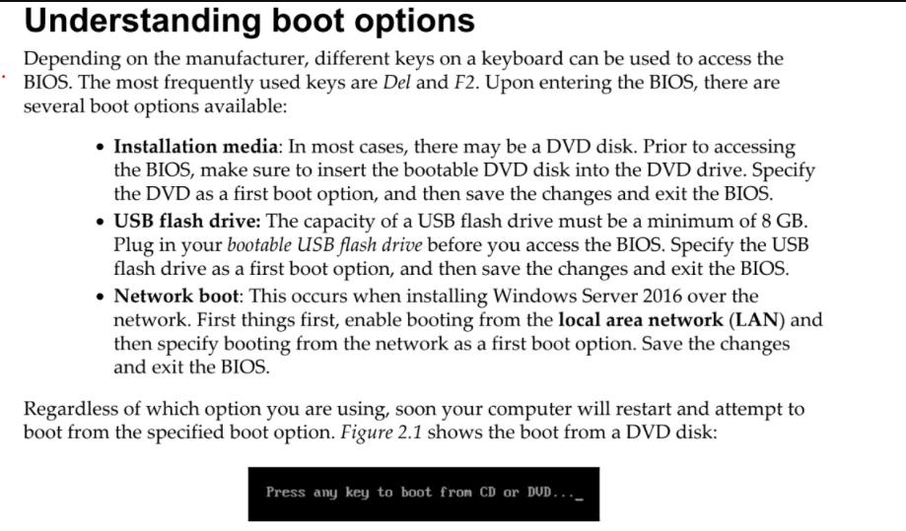
Ref.

Slide 6
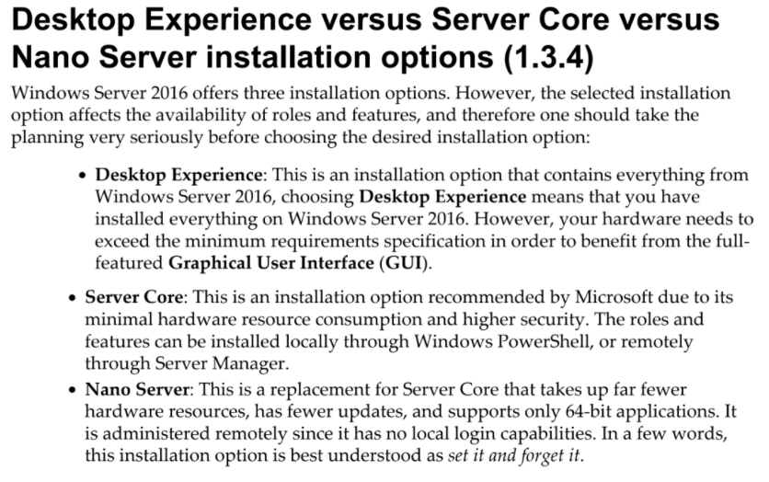
Ref.

Slide 7
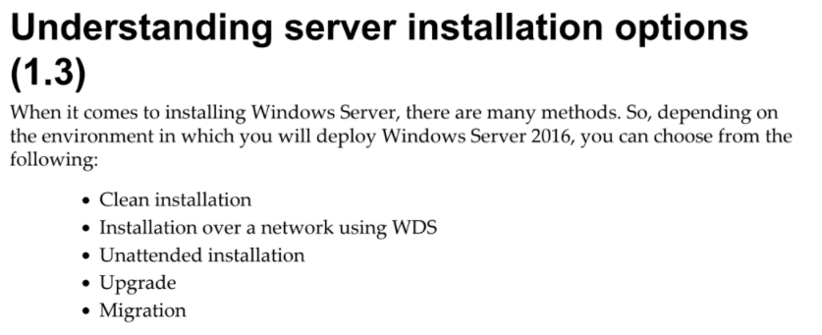
Ref.

Slide 8
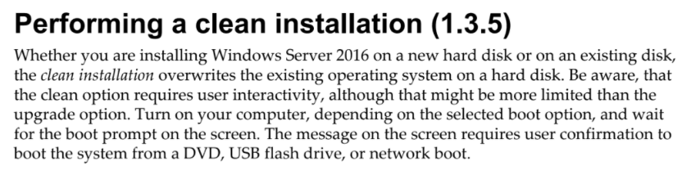
Windows Deployment Services(WDS) is a server role that gives administrators the ability
to deploy Windows operating systems remotely.
WDS can be used for network-based installations to set up new computers
so administrators do not have to directly install each operating system (OS).

Slide 9
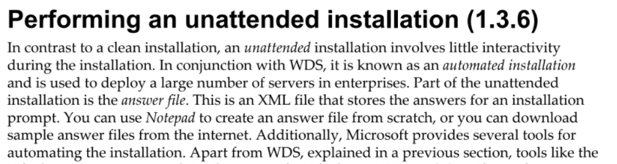


Slide 10
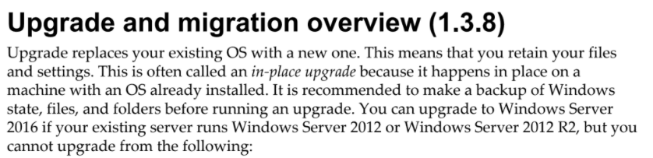
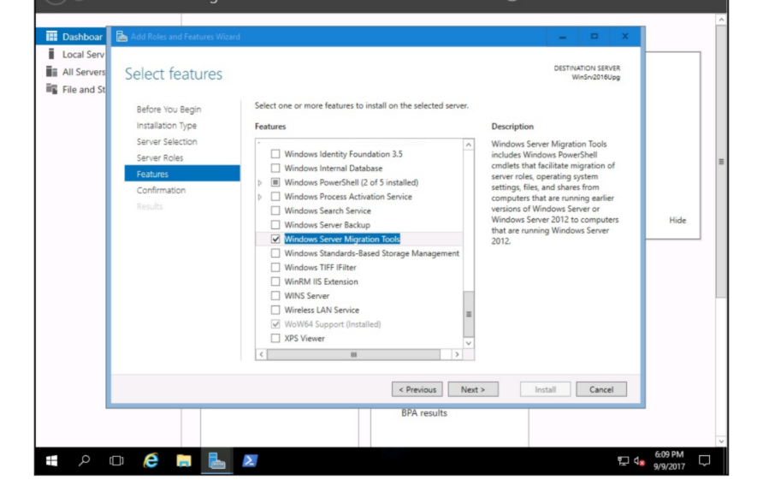

Slide 11
File services (Windows)
File Services role not only configures settings to optimize the system for file sharing, but also enables the administrator to choose which file server options as well as which tools for managing the file system will be installed.
A file server is a central server in a computer network that provides file systems or at least parts of a file system to connected clients.
File servers therefore offer users a central storage place for files on internal data media, which is accessible to all authorized clients.

Slide 12
Role description of File and Storage Services.
File and Storage Services includes technologies that help you set up and manage one or more file servers, which are servers that provide central locations on your network where you can store files and share them with users.
File Server
A file server provides a central location on your network where you can store files and share them with users across your network. When users require an important file that is intended to be accessed by many users, such as a project plan, they can access the file remotely on the file server instead of having to pass the file between their separate computers.
If your network users need access to the same files and applications, or if centralized backup and file management are important to your organization, you should configure this computer as a file server by adding the File Services role.

Slide 13
Service is a program, routine or process that perform a specific system function to support other programs or to provide a network service.
A service run in the background without user interface.
Example of services are web serving , event logging and file serving.
To manage services, use service console located under Administrative tools.

Slide 14
Microsoft COM+, also known as Component Services, provides a transaction processing system for developing, deploying, and managing high performance, scalable, and robust enterprise, Internet, and intranet server applications.
They also provide a run-time infrastructure for deploying and managing these applications.
DCOM (Distributed Component Object Model) is a proprietary Microsoft software component that allows COM objects to communicate with each other over the network.
How to open Component Services through Run Command in windows
Open Run by pressing Windowskey+R.
Type "dcomcnfg"
Press Enter key or Click on Ok.
After that you will see another window will open with Component Services.

Slide 15
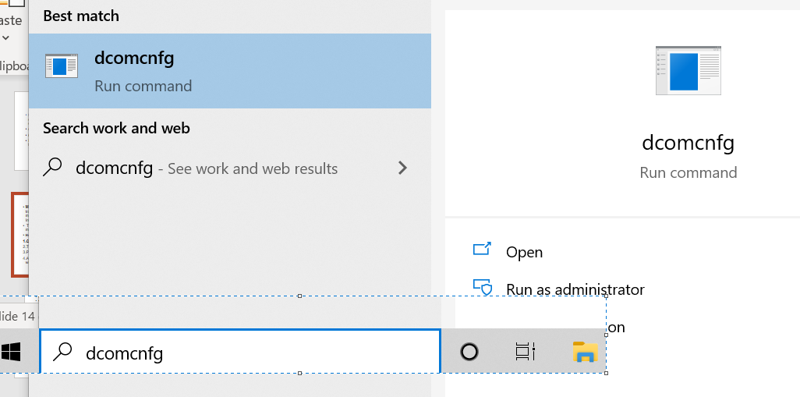

Slide 16
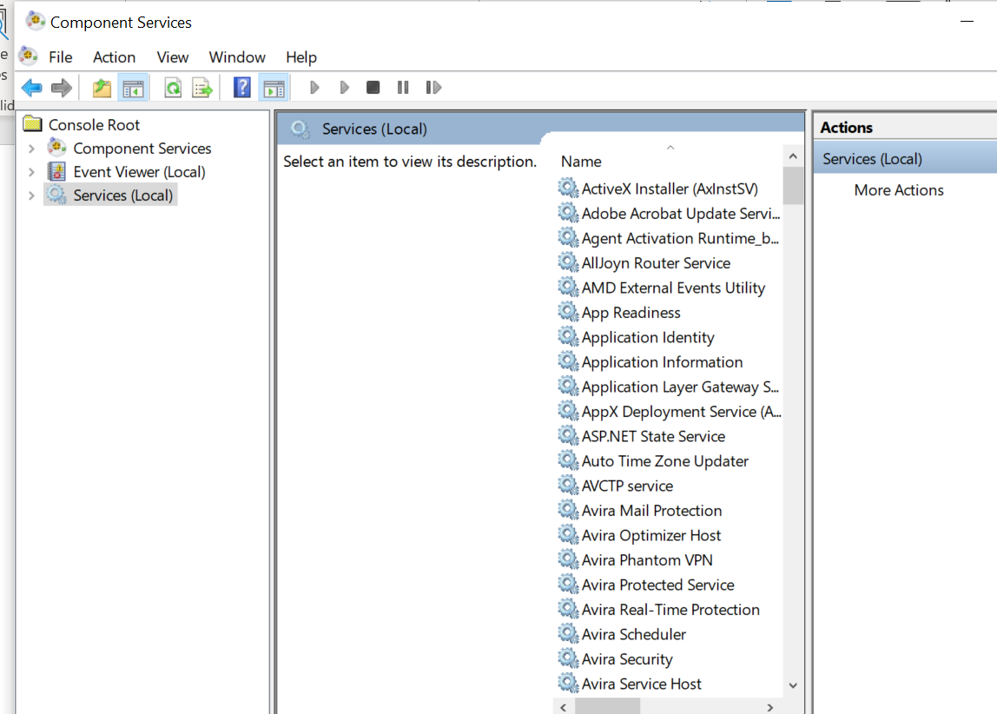

Slide 17
The registry is a central, secure database in which Windows stores all hardware configuration information, software configuration information, and system security policies.
Components that use the registry include the Windows kernel, device drivers, setup programs, hardware profiles, and user profiles.
To view and manually change the registry, you use the Registry Editor (Regedit.exe), which can be executed from the command prompt, Start Search box, or Run box.

Slide 18
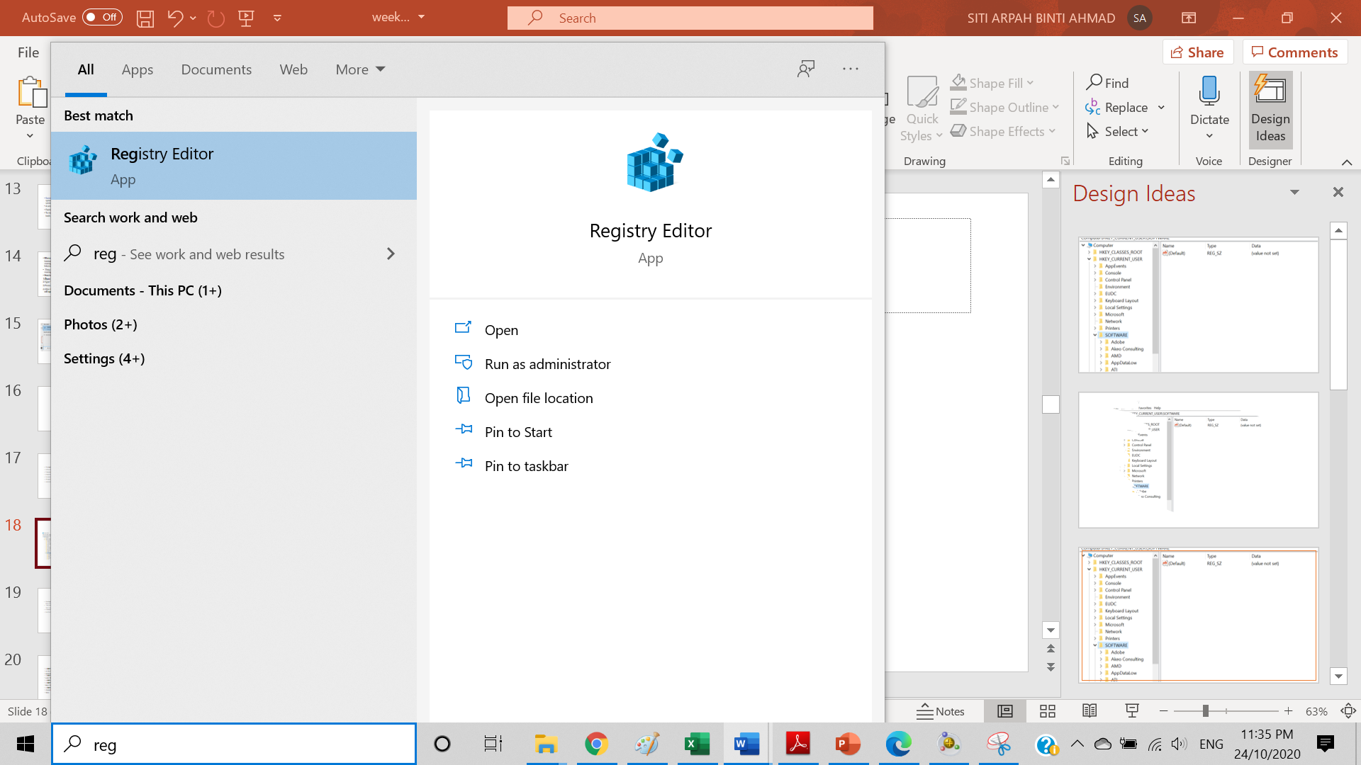

Slide 19
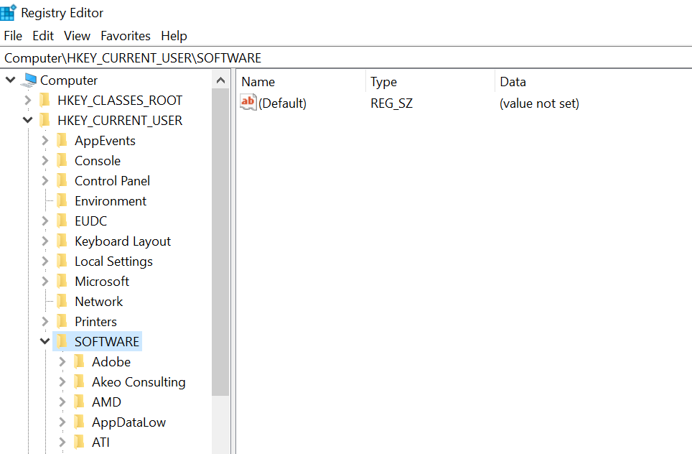

Slide 20
The Registry is split into several logical sections, often referred to as hives, which are generally named by their Windows API definitions.
The hives begin with HKEY and are often abbreviated to a three- or four-letter short name starting with “HK.” For example, HKCU is HKEY_
CURRENT_USER and HKLM is HKEY_LOCAL_MACHINE.
Windows Server 2008 R2 has five Root Keys/HKEYs:
Application Programming Interface (API)
is a software intermediary that allows two applications to talk to each other.
Each time you use an app like Facebook, send an instant message, or check the weather on your phone, you're using an API.
The Windows API (application programming interface) allows user-written programs to interact with Windows.

Slide 21
• HKEY_CLASSES_ROOT: Stores information about registered applications, such
as the file association that tells which default program opens a file with a certain
extension.
• HKEY_CURRENT_USER: Stores settings that are specific to the currently logged-in
user. When a user logs off, the HKEY_CURRENT_USER is saved to HKEY_USERS.
• HKEY_LOCAL_MACHINE: Stores settings that are specific to the local computer.
• HKEY_USERS: Contains subkeys corresponding to the HKEY_CURRENT_USER
keys for each user profile actively loaded on the machine.
• HKEY_CURRENT_CONFIG: Contains information gathered at run time.
Information stored in this key is not permanently stored on disk, but rather regenerated at the boot time.

Slide 22
Registry keys are similar to folders, which can contain values or subkeys.
The keys within the registry follow a syntax similar to a Windows folder or file path using backslashes to separate each level.
example:
HKEY_LOCAL_MACHINE\Software\Microsoft\Windows
refers to the subkey “Windows” of the subkey “Microsoft” of the subkey “Software” of the HKEY_LOCAL_MACHINE key.

Slide 23
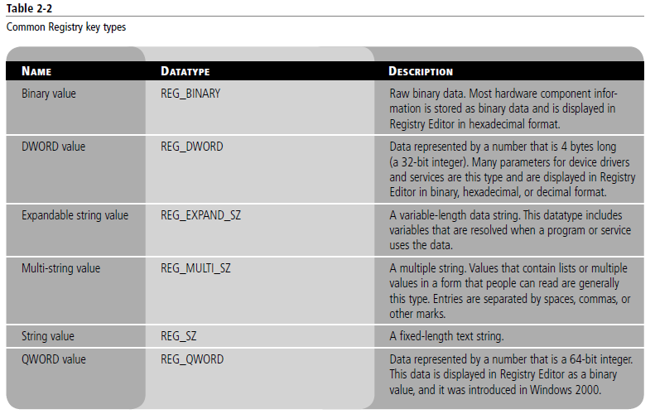

Slide 24
Reg files (also known as Registration entries) are text files used for storing portions of the registry.
They have a.reg filename extension.
If you double-click a reg file, it will add the registry entries into the registry.
You can export any registry subkey by right-clicking the subkey and choosing Export.
You can back up the entire registry to a reg file by right-clicking
Computer at the top of Regedit and selecting export, or you can back up the system state with Windows Backup.

Slide 25
Authentication
In computing, authentication is the process of verifying the identity of a person or device.
A common example is entering a username and password when you log in to a website.
a username/password combination is a common way to authenticate your identity, many other types of authentication exist.

Slide 26
An authentication server provides a network service that applications use to authenticate the credentials, usually account names and passwords, of their users.
When a client submits a valid set of credentials, it receives a cryptographic ticket that it can subsequently use to access various services.

Slide 27
Windows Server authentication
Windows Authentication is used to verify that the information comes from a trusted source, whether from a person or computer object, such as another computer.

Slide 28
What is file service
Network File Service (NFS) A set of protocols that run over an Ethernet network and offer support for file transfer and access, and for paging.

Slide 29
In computer operating systems, paging is a memory management scheme by which a computer stores and retrieves data from secondary storage for use in main memory.
In this scheme, the operating system retrieves data from secondary storage in same-size blocks called pages.
A paging file is a hidden, optional system storage file on a hard disk. Only one is installed on each hard disk, although more can be added.
The paging file can support system crashes and expand the amount of system-committed memory, or virtual memory, that a system can back

Slide 30
File Server Resource Manager
File Server Resource Manager (FSRM) is a role service in Windows Server that enables you to manage and classify data stored on file servers.
You can use File Server Resource Manager to:
1- automatically classify files,
2- perform tasks based on these classifications
3- set quotas on folders,
4-create reports monitoring storage usage.
Ref:
https://docs.microsoft.com/en-us/windows-server/storage/fsrm/fsrm-overview

Slide 31
File Server Resource Manager Features
File Server Resource Manager includes the following features:
Quota management
File Classification Infrastructure
File Management Tasks
File screening management
Storage reports
The features included with File Server Resource Manager can be configured and managed by using the File Server Resource Manager app or by using Windows PowerShell.

Slide 32
PowerShell is a task automation and configuration management framework from Microsoft, consisting of a command-line shell and the associated scripting language.
https://www.tutorialspoint.com/powershell/powershell_environment.htm

Slide 33
File Server Resource Manager includes the following features:
Quota management allows you to limit the space that is allowed for a volume or folder, and they can be automatically applied to new folders that are created on a volume. You can also define quota templates that can be applied to new volumes or folders.
File Classification Infrastructure provides insight into your data by automating classification processes so that you can manage your data more effectively. You can classify files and apply policies based on this classification. Example policies include dynamic access control for restricting access to files, file encryption, and file expiration. Files can be classified automatically by using file classification rules or manually by modifying the properties of a selected file or folder.
File Management Tasks enables you to apply a conditional policy or action to files based on their classification. The conditions of a file management task include the file location, the classification properties, the date the file was created, the last modified date of the file, or the last time the file was accessed. The actions that a file management task can take include the ability to expire files, encrypt files, or run a custom command.
File screening management helps you control the types of files that user can store on a file server. You can limit the extension that can be stored on your shared files. For example, you can create a file screen that does not allow files with an MP3 extension to be stored in personal shared folders on a file server.
Storage reports help you identify trends in disk usage and how your data is classified. You can also monitor a selected group of users for attempts to save unauthorized files.
The features included with File Server Resource Manager can be configured and managed by using the File Server Resource Manager app or by using Windows PowerShell.

Slide 34
Practical applications
Some practical applications for File Server Resource Manager include:
Use File Classification Infrastructure with the Dynamic Access Control scenario to create a policy that grants access to files and folders based on the way files are classified on the file server.
Create a file classification rule that tags any file that contains at least 10 social security numbers as having personally identifiable information.
Expire any file that has not been modified in the last 10 years.
Create a 200 megabyte quota for each user's home directory and notify them when they are using 180 megabytes.
Do not allow any music files to be stored in personal shared folders.
Schedule a report that runs every Sunday night at midnight that generates a list of the most recently accessed files from the previous two days.
This can help you determine the weekend storage activity and plan your server downtime accordingly.

Slide 35

The End

